Slide 1
HYDROCARBON

Slide 2
ALKANES
members of a homologous series
general formula is C_{n}H_{2n+2}
saturated hydrocarbons
all carbon-carbon bonding are single
bonds are spaced tetrahedrally around carbon atoms.

Slide 3
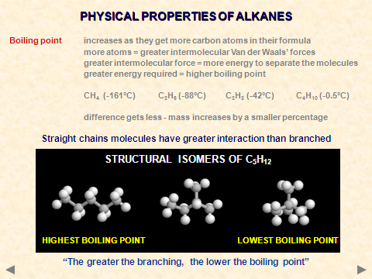

Slide 4
Unreactivity of alkanes
1. Unreactive because:
Absence of a functional group
Non-polar therefore unreactive towards water or polar reagents like HBr etc.
2. React with non polar reagents like Cl₂ or
Br₂ only in the presence of ultra violet light
or sunlight.

Slide 5
Reaction of alkanes
Combustion
Burns exothermically in excess oxygen to form CO₂ and H₂O
eg: CH₄ + 2O₂ ➔ CO₂ + 2H₂O
In general,
C_{x}H_{y} + (x+y/4)O₂ ➔ xCO₂ + y/2H₂O
When burned in a limited air supply (O₂), CO & C are also formed: Incomplete combustion.
eg: C₄H₁₀ + 9/2O₂ ➔ 4CO + 5H₂O

Slide 6
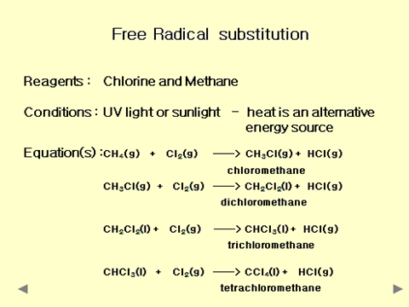

Slide 7
Free Radical Substitution
Mixtures free radicals are very reactive - they are trying to pair their electron with sufficient chlorine so that every hydrogen will eventually be replaced.
Mechanism Mechanisms portray what chemists think is going on in the reaction, whereas an equation tells you the ratio of products
and reactants.
Chlorination of methane proceeds via FREE RADICAL SUBSTITUTION because the methane is attacked by free
radicals resulting in hydrogen atoms being substituted by chlorine atoms.

Slide 8
Free Radical Substitution
This occurs in 3 steps:
1. Initiation
2. Propagation
3. Termination
The process is a chain reaction.
In the propagation step, one radical is produced for each one used.
https://www.youtube.com/watch?feature=player_detailpage&v=VIHtLIb-oZo

Slide 9

Free Radical Substitution
Initiation Cl₂ ——> 2Cl• RADICALS CREATED
The single dots represent UNPAIRED ELECTRONS
During initiation, the WEAKEST BOND IS BROKEN as it requires less energy.
There are three possible bonds in a mixture of alkanes and chlorine.
412 348 242
Average bond enthalpy kJ mol⁻¹
The Cl-Cl bond is broken in preference to the others as it is the weakest and requires less energy to separate the atoms.

Slide 10
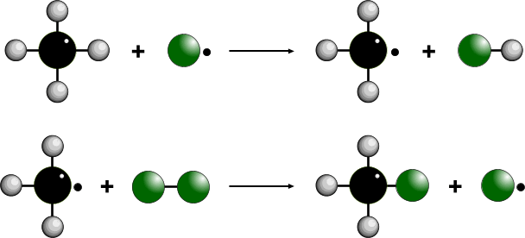
Free Radical Substitution
Propagation CH₄ + Cl• ——> CH₃• + HCl RADICALS USED
and CH₃• + Cl₂——> CH₃Cl + Cl• then RE-GENERATED
Free radicals are very reactive because they want to pair up their single electron.
They do this by abstracting a hydrogen atom from methane; a methyl radical is formed
The methyl radical is also very reactive and attacks a chlorine molecule
A chlorine radical is produced and the whole process can start all over again.

Slide 11
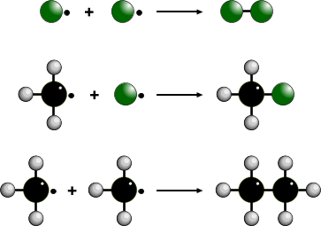
Free Radical substitution
Termination Cl• + Cl• ——> Cl₂ RADICALS REMOVED
Cl• + CH₃• ——> CH₃Cl
CH₃• + CH₃• ——> C₂H₆
Removing the reactive free radicals brings an end to the reaction.
This is not very likely at the start of the reaction because of their low concentration.

Slide 12
Free Radical Substitution
SUMMARY
Initiation Cl₂ ——> 2Cl• radicals created
Propagation CH₄ + Cl• ——> CH₃• + HCl radicals used and
CH₃• + Cl₂ ——> CH₃Cl + Cl• then re-generated
CH₃Cl + Cl• ——> CH₂Cl• + HCl
CH₂Cl • + Cl₂ ——> CH₂Cl₂ + Cl•
CH₂Cl₂ + Cl• ——> CHCl₂• + HCl
CHCl₂• + Cl₂ ——> CHCl₃ + Cl•
CHCl₃ + Cl• ——> CCl₃• + HCl
CCl₃• + Cl₂ ——> CCl₄ + Cl•
Termination Cl• + Cl• ——> Cl₂ radicals removed
Cl• + CH₃• ——> CH₃Cl
CH₃• + CH₃• ——> C₂H₆

Slide 13
CRACKING
Involves the breaking of C-C bonds in alkanes
Converts heavy fractions into higher value products
THERMAL CRACKING
CATALYTIC CRACKING
Used to provide extra gasoline and a source of alkenes.
In motor car engine, petrol vapour and air are ignited by an electric spark, producing an explosive reaction. This drives the piston of the engine.

Slide 14
CRACKING
Gasoline mixtures that are rich in straight-chain alkenes causes ‘knocking’ and inefficient combustion.
Combustion of branched chain alkanes is much smoother and controlled (more efficient fuels and cause less knocking)

Slide 15
CRACKING
Petrol additives : Tetraethyl lead (IV), Pb(C₂H₅)₄, which is an anti-knocking agent is added to prevent pre-ignition in petrol.
When burned, PbO produced combines with free radicals producing smoother ignition.
To prevent Pb accumulating, 1,2-dibromoethane is added to petrol to remove PbBr₂ which is volatile and emmited in exhaust fumes.

Slide 16
THERMAL CRACKING
HIGH PRESSURE ... 7000 kPa
HIGH TEMPERATURE ... 400°C to 900°C
PRODUCES MOSTLY ALKENES ... e.g. ETHENE for making polymers and ethanol
PRODUCES HYDROGEN ... used in the Haber Process and in margarine manufacture
Bonds can be broken anywhere in the molecule by C-C bond fission or C-H bond fission

Slide 17
Catalytic Cracking to obtain alkenes & alkanes
Heating (450°C)the oil fraction with a catalyst (Al₂O₃ or SiO₂)
High molecular mass alkanes broken down into low-molecular mass alkane & alkene.
Bond-breaking is random.
Decane → butene + hexane
C₁₀H₂₂ → C₄H₈ + C₆H₁₄

Slide 18
Environmental consequences
Fossil fuels are non-renewable
CO₂ produced is a major contributor to green house gases.
Spillage causes contamination to streams & ponds.
Inefficient burning gives CO instead of CO₂. Inhalation causes death.
Burning fuels gives NO₂,NO,SO₂,SO₃ which gives acid rain.

Slide 19
ALKENES

Slide 20

THE STRUCTURE OF ALKENES
General are members of a homologous series
hydrocarbons - contain only C and H
general formula is C_{n}H_{2n} - for non-cyclic alkenes
unsaturated - atoms can be added to their formula
contain a C=C double bond somewhere in their structure
Structure spacial arrangement around the C=C is planar
the bond angles are 120°

Slide 21
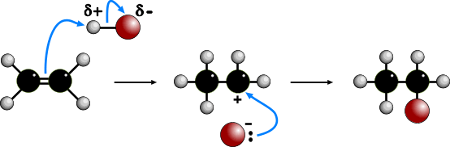
CHEMICAL PROPERTIES OF ALKENES
ELECTROPHILIC ADDITION OF HYDROGEN BROMIDE
Reagent Hydrogen bromide... it is electrophilic as the H is slightly positive
Condition Room temperature.
Equation C₂H₄(g) + HBr(g) ———> C₂H₅Br(l) bromoethane
Mechanism ELECTROPHILIC ADDITION
Step 1 As the HBr nears the alkene, one of the carbon-carbon bonds breaks
The pair of electrons attaches to the slightly positive H end of H-Br.
The HBr bond breaks to form a bromide ion.
A carbocation (positively charged carbon species) is formed.
Step 2 The bromide ion behaves as a nucleophile and attacks the carbocation.
Overall there has been addition of HBr across the double bond.

Slide 22
https://www.youtube.com/watch?feature=player_detailpage&v=YnD42ZTPdFU

Slide 23
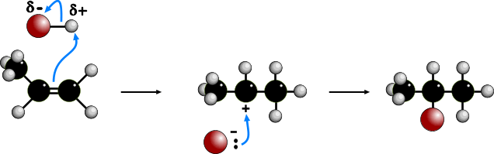
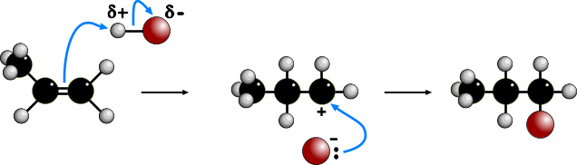
ELECTROPHILIC ADDITION TO UNSYMMETRICAL ALKENES
MARKOVNIKOFF’S RULE
In the addition to propene, path A involves a 2° carbocation, path B a 1° carbocation.
As the 2° ion is more stable, the major product (i.e. 2-bromopropane) is formed this way.
PATH A
SECONDARY
CARBOCATION
MAJOR PRODUCT
PATH B
PRIMARY
CARBOCATION
MINOR PRODUCT

Slide 24
https://i2.ytimg.com/vi/EWOvFAu8FmA/mqdefault.jpg

Slide 25

Stability of carbocation
3º carbocation is more stable than 2º due to 3 electron donating groups.
2º carbocation is more stable than 1º carbocation due to 2 electron donating groups.

Slide 26


Slide 27
Electrophilic Addition of Hydrogen (Hydrogenation)
Heat in the presence of Ni catalyst at 150°C or pass over Pt at room temperature.
Reaction for ethene (product is an alkane) :

Slide 28
Electrophilic Addition of Steam (Hydration)
Heat in the presence of H₃PO₄ catalysts at 300˚C & 70atm.
Reaction for ethene (product is an alcohol) :

Slide 29
Electrophilic Addition of (Halogenation)
Add X₂ at room temperature (absence of uv light)
Reaction for C₂H₄ + Br₂ in CCl₄
Reaction for C₂H₄ + Br_{2(aq)}

Slide 30
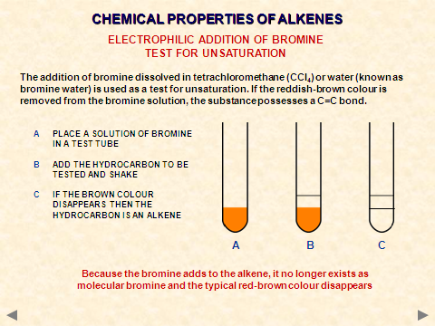

Slide 31
Oxidation of Alkene
Oxidation by cold potassium manganate (VII) in dilute H₂SO₄ to form diol (alcohol with 2
-OH groups adjacent to one another)

Slide 32
Oxidation of Alkene
Oxidation by hot, potassium manganate (VII) in concentrated H₂SO₄ leading to rupture of C=C to determine position of alkene linkage.

Slide 33


POLYMERISATION OF ALKENES
ADDITION POLYMERISATION
Process • during polymerisation, an alkene undergoes an addition reaction with itself
• all the atoms in the original alkenes are used to form the polymer
• long hydrocarbon chains are formed
the equation shows the original monomer and the repeating unit in the
polymer
ethene poly(ethene)
MONOMER POLYMER
n represents a large number

Slide 34
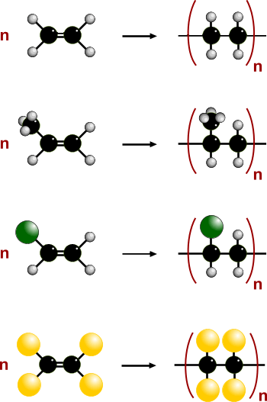
POLYMERISATION OF ALKENES
EXAMPLES OF ADDITION POLYMERISATION
ETHENE
POLY(ETHENE)
PROPENE
POLY(PROPENE)
CHLOROETHENE
POLY(CHLOROETHENE)
POLYVINYLCHLORIDE PVC
TETRAFLUOROETHENE
POLY(TETRAFLUOROETHENE)
PTFE “Teflon”

Slide 35
Disposal of Polymer
Polyalkenes are non-biodegradable (not decomposed by bacteria in the ground)
Can be destroyed by complete burning which will produce carbon dioxide and water.
Combustion of polyalkenes can cause:
-incomplete combustion which produce poisonous CO
-incomplete combustion of polystyrene which produce a lot of poisonous hydrocarbons such as benzene.
PVC produce HCl on burning. Adds acidity to soil.
Some plastics contain CN group which reacts with haemoglobin causing fatal.

Slide 36
